Slide 1
Chapter 8
Transformation

Slide 2
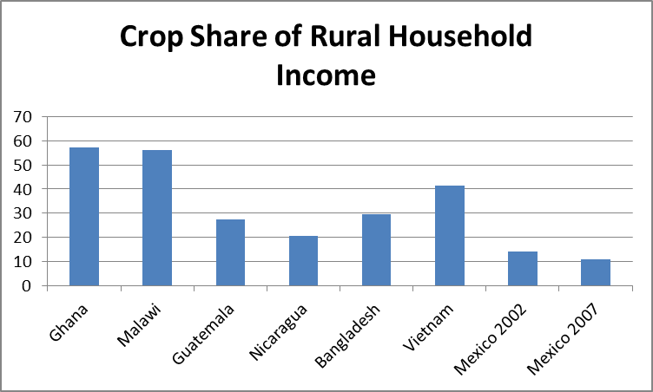
Less Rural, Less Agricultural
On May 23, 2007, the world became more urban than rural
Rural economies are becoming less agricultural
Sources: Winters, P., Davis, B., Carletto, G., Covarrubias, K., Quinones, E., Zezza, A. 2009. "Assets, Activities and Rural Income Generation: Evidence from a Multicountry Analysis." World Development, 37(9), 1435-1452 (Table 2) and tabulation of Mexico National Rural Household Survey (ENHRUM) data.

Slide 3
The Agricultural Transformation (Timmer)
Stage 1: Agricultural productivity per agricultural worker begins to rise
  creating an economic surplus
Stage 2: This surplus is tapped to expand the modern sector (Lewis model)
Stage 3: The agricultural sector becomes increasingly integrated with other sectors of the economy as markets develop
Stage 4: Agriculture is just another sector of the economy
  …but often wins large subsidies in rich countries

Slide 4
Why Diversification Matters
Solving poverty: Should we focus on crop production? Staples?
  Hard to “move” poverty with staples if the staple share of rural household income is low
Impact of global food price increases on rural welfare
  Negative if food production is a small share of rural income
What happens to households’ welfare?
  Wrenching changes
  Can people compete in a changing economy?
  Who diversifies and who doesn’t?

Slide 5
Who Diversifies and Who Doesn’t?
Big implications for welfare; 2 views
Push: Households diversify to spread risks
  Sacrificing expected income by not specializing
  The poor lose most from this
Pull: Diversify to take advantage of higher returns
  Diminishing marginal returns in agriculture, scale
  Incomes higher if you can diversify
  But there may be high costs, risks of entering new activities
    Barriers of entry highest for poor (see Reardon box in Ch. 8)

Slide 6
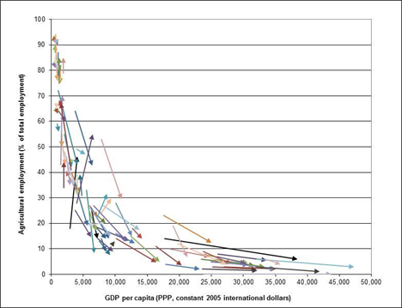
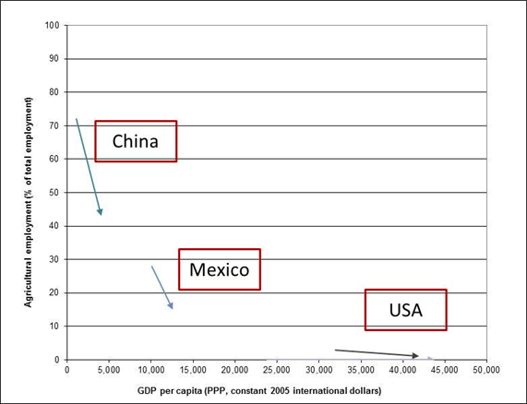
Everyone Is Fleeing the Farm
Income Growth and Ag Labor Shares
Source: Taylor and Lybbert, RebelText: Essentials of Development Economics, 2012

Slide 7
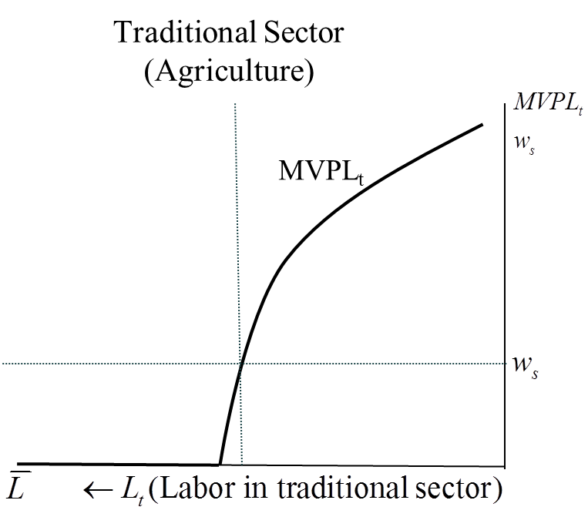
Beyond Agriculture: The Lewis Model
t: Traditional sector
m: Modern sector
MVPL_{t}, MVPL_{m} : Marginal value products
w_{s}: Subsistence wage
LS_{m}: Labor supply to modern sector
Initial labor in traditional sector

Slide 8
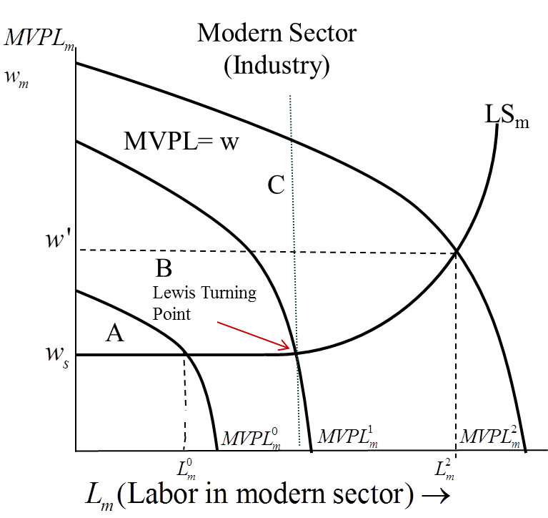
Beyond Agriculture: The Lewis Model
t: Traditional sector
m: Modern sector
MVPL_{t}, MVPL_{m} : Marginal value products
w_{s}: Subsistence wage
LS_{m}: Labor supply to modern sector
Initial labor in traditional sector

Slide 9
Beyond Agriculture: The Lewis Model
t: Traditional sector
m: Modern sector
MVPL_{t}, MVPL_{m} : Marginal value products
w_{s}: Subsistence wage
LS_{m}: Labor supply to modern sector
Initial labor in traditional sector

Slide 10
Criticisms and Implications of Lewis Model
Still an aggregate model
  Who moves off the farm, and who doesn’t?
Can agriculture lose labor and not output?
  TW Schultz doesn’t think so (see China box)
Ranis and Fei: Better invest in agriculture if want the modern sector to grow!
Everything depends on markets working (Chapter 9)
Impacts of migration on rural economies

Slide 11
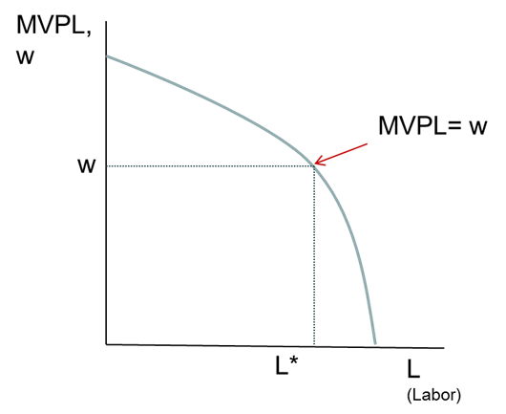
Who Leaves and Who Stays Behind?
Workers take their human capital to the labor market where it will give them the highest returns, in terms of employment and wages
Returns to schooling and experience are higher in the city
…so HK Theory predicts people with more human capital are more likely to migrate

Slide 12
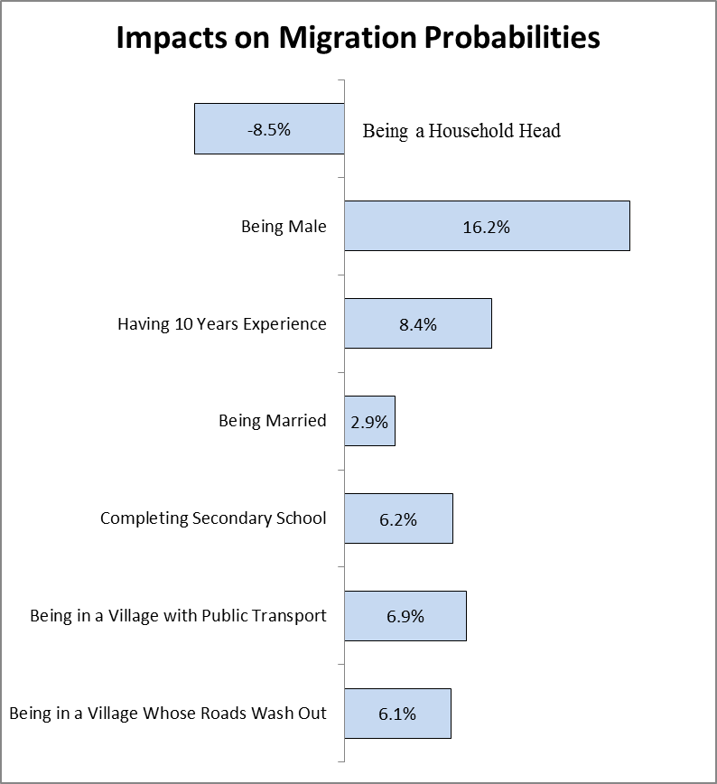
Migration is Selective
Source: Mexico National Rural Household Survey, 2008

Slide 13
Too Much Migration?
In 2000 one slum in Mumbai, India, covered 175 acres with a population density of an astounding 1,200 people per acre!
By 2003, nearly a third of the world’s urban population—almost one billion people—lived in slums, according to the United Nations.
In many of the world’s slums, most people live in makeshift dwellings on land they are not authorized to occupy.
Jan Nijman, “A Study of Space in Mumbai’s Slums,” Tijdschrift voor economische en sociale geografie, Volume 101, Issue 1, pages 4–17, February 2010.
United Nations Human Settlements Programme. The challenge of slums: global report on human settlements 2003. Earthscan, 2003.

Slide 14

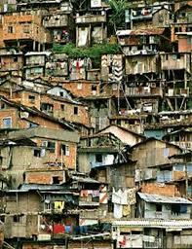
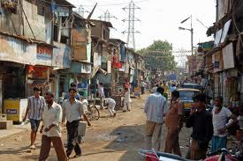



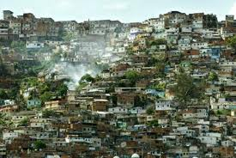
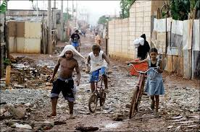

Slide 15
Why Migrate to Become Unemployed and Live in a Slum?
The Facts:
  Urban wages are higher than rural wages (or the marginal value product of labor on the farm)
    Why?
  The migration isn’t closing the rural-urban wage gap
    Why not?
  People continue to migrate even in the face of high urban unemployment

Slide 16
The Todaro Migration Model
Michael Todaro: People know there’s unemployment
  …so they look at the expected wage and migrate if:
Cost of migrating (including psychic costs of leaving the farm)
Expected rural wage
Expected urban wage
Example: Urban wage = $6/day, probability of finding an urban job is 0.5, so expected urban wage is .5*$6 = $3
…if expected rural wage is, say, $2 (and costs are low), you’ll migrate
  EVEN THOUGH THERE’S 50% UNEMPLOYMENT IN THE CITY!

Slide 17
How Do You Fight Urban Unemployment in a Todaro World?
Create more urban jobs? (Hint: what happens to p_{u}?)
Urban minimum wage laws? (Bad idea, according to Todaro)
Public works projects to clean up the slums? (What does this do the nonpecuniary costs and benefits of migrating?)
Rural employment and agricultural investment programs? (Yes! Think linkages…)

Slide 18
The Rise of CGEs for Policy Analysis
Simulate the workings of complex economies
Production sectors produce output, buy inputs, pay factors
Factors channel money into households
Households spend and save
Model adds up all quantities produced, demanded in the economy
Either prices or net imports adjust to make all markets equilibrate
Use model as laboratory to simulate impacts of policies and other shocks

Slide 19
A Picture of an Economy-wide Model
Policy
Inputs
Labor
=
Producers
Supply
Demand
Consumers
Factor Owners
Capital
S(prices, fixed factors)
D(prices, incomes)
Land
Fields
Rice
Mixed
Pasture
Other
Cereals/Oilseeds
Wheat
Oilseeds
Coarse
Notes:
All is centered around market clearing in partial equilibrium. Supply = Demand.
Demand comes from consumers, and supply from producers. Factor markets support production, and land supply is CET.
When a policy hits, all prices update and all markets clear in response.
Welfare effects is calculated independently for consumers, producers and factor owners.

